Slide 1


Language Translation-Transformer Based Model
NAME | ROLL
KUMAR SAURABH | 13000118094
AYUSHI KUMARI | 13000118110
ABHIJEET KARMAKAR | 13000118141
ABHAY KUMAR CHOUBEY | 13000118142
Notes:
NOTE: To replace a picture, just select and delete it. Then use the Insert Picture icon to replace it with one of your own!

Slide 2
Need of the Project
As our world becomes increasingly connected, language translation provides a critical cultural and economic bridge between people from different countries and ethnic groups. Some of the more obvious use-cases include:
business: international trade, investment, contracts, finance
commerce: travel, purchase of foreign goods and services, customer support
media: accessing information via search, sharing information via social networks, localization of content and advertising
education: sharing of ideas, collaboration, translation of research papers
government: foreign relations, negotiation
Notes:
This template was inserted from Power-user, the productivity add-in for PowerPoint, Excel and Word.
Get thousands of templates, icons, maps, diagrams and charts with Power-user. Visit www.powerusersoftwares.com!

Slide 3
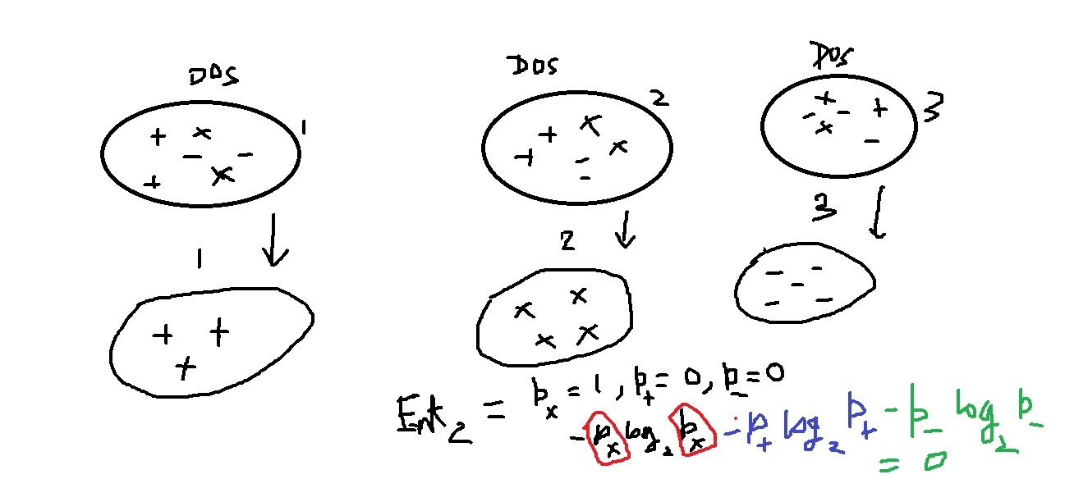
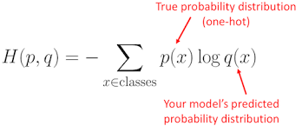
Entropy
Entropy is the measure of degree of Disorder/Randomness.
Our goal is to achieve a set of ordered set from a set of disordered set.
Initially, when all the classes are mixed ,then entropy is high
and when all classes is classified ,entropy will be minimum.
Cross entropy can be interpreted as the expected message-length per datum when a wrong distribution is assumed while the data actually follows a distribution p.
Notes:
This template was inserted from Power-user, the productivity add-in for PowerPoint, Excel and Word.
Get thousands of templates, icons, maps, diagrams and charts with Power-user. Visit www.powerusersoftwares.com!

Slide 4
What is The Transformer???
weighting the significance of each part of the input data
adopts the mechanism of self-attention,
primarily in the field of natural language
processing (NLP) and in computer vision (CV)
deep learning model
Notes:
This template was inserted from Power-user, the productivity add-in for PowerPoint, Excel and Word.
Get thousands of templates, icons, maps, diagrams and charts with Power-user. Visit www.powerusersoftwares.com!

Slide 5
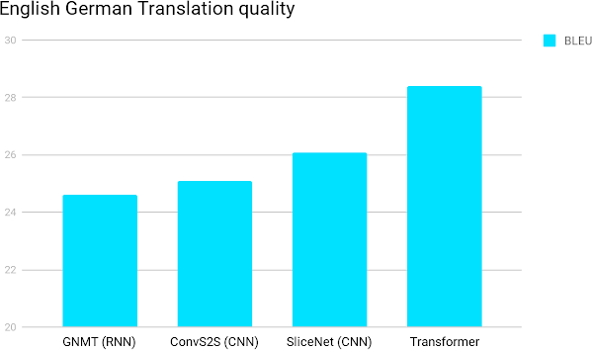
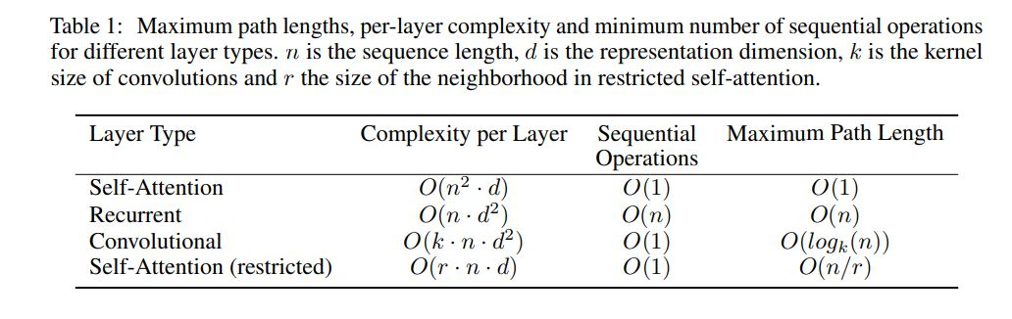
Why transformer over other modules.
Transformers are better than all the other architectures because they totally avoid recursion, by processing sentences as a whole and by learning relationships between words thanks to multi-head attention mechanisms and positional embeddings.

Slide 6

A High-Level Look
Text
Encoders
It consists of encoding layers that process the input iteratively one layer after another
Text
Decoders
consists two multi-headed attention layers, a pointwise feed-forward layer, and residual connections, and layer normalization after each sub-layer.
Notes:
This template was inserted from Power-user, the productivity add-in for PowerPoint, Excel and Word.
Get thousands of templates, icons, maps, diagrams and charts with Power-user. Visit www.powerusersoftwares.com!

Slide 7
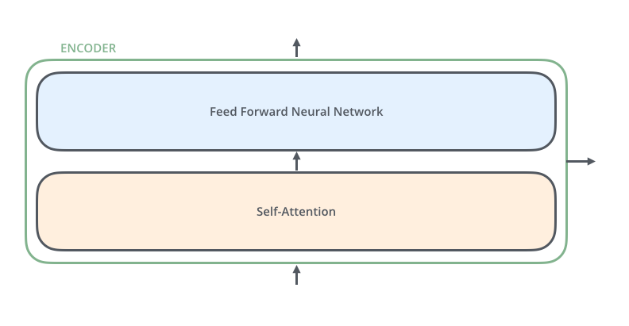
Encoder
The encoder’s inputs first flow through a self-attention layer .
The outputs of the self-attention layer are fed to a feed-forward neural network.
The exact same feed-forward network is independently applied to each position.
Self –attention tells where we should focus in output language for determining the next word.
Notes:
This template was inserted from Power-user, the productivity add-in for PowerPoint, Excel and Word.
Get thousands of templates, icons, maps, diagrams and charts with Power-user. Visit www.powerusersoftwares.com!

Slide 8
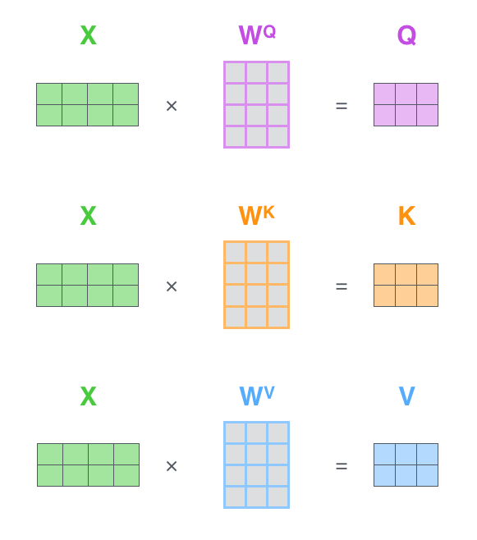
Self-Attention
Matrix calculation of self-Attention
Step 1:-
The first step is to calculate the Query, Key, and Value matrices. We do that by packing our embeddings into a matrix X, and multiplying it by the weight matrices we’ve trained (WQ, WK, WV).
Notes:
This template was inserted from Power-user, the productivity add-in for PowerPoint, Excel and Word.
Get thousands of templates, icons, maps, diagrams and charts with Power-user. Visit www.powerusersoftwares.com!

Slide 9
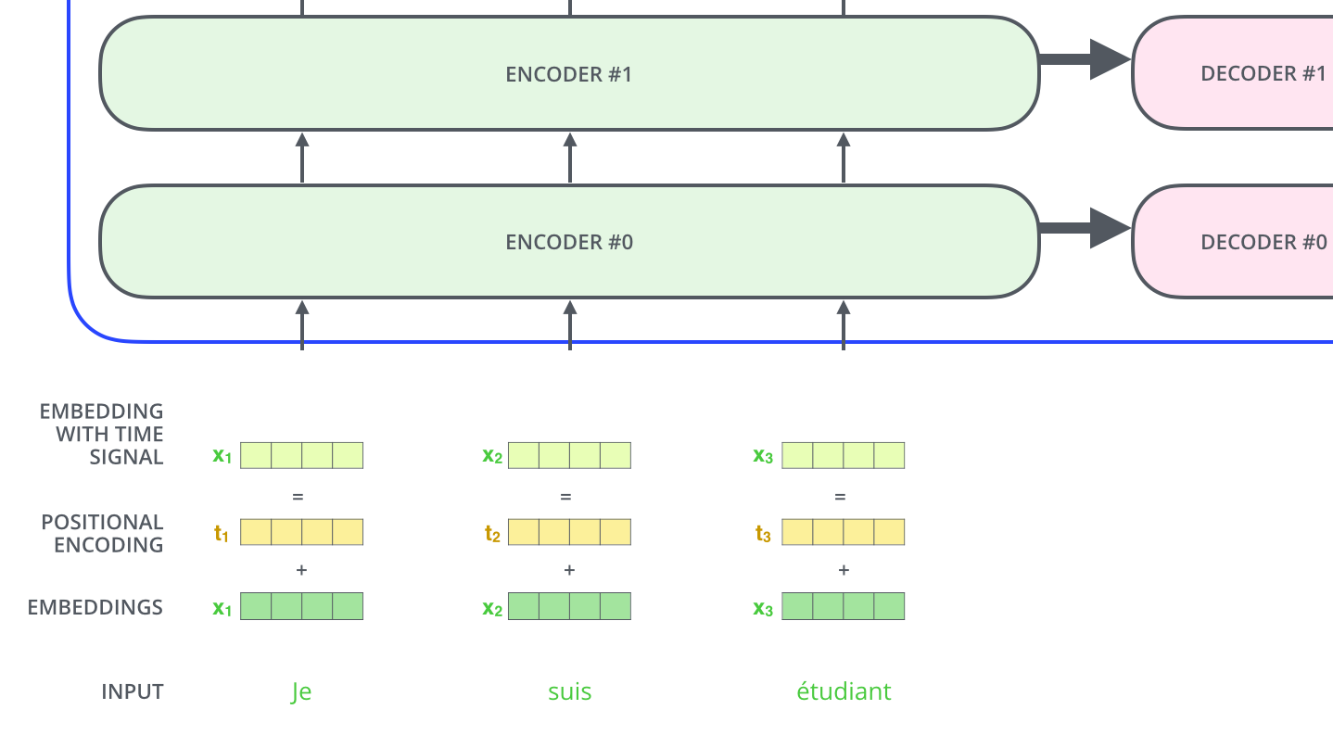
Positional Encoding
The transformer adds a vector to each input embedding.
These vectors follow a specific pattern that the model learns, which helps it determine the position of each word,
or the distance between different words in the sequence.
Notes:
This template was inserted from Power-user, the productivity add-in for PowerPoint, Excel and Word.
Get thousands of templates, icons, maps, diagrams and charts with Power-user. Visit www.powerusersoftwares.com!

Slide 10

Matrix calculation of self-Attention
Step 2:-
Finally, since we’re dealing with matrices,
we can condense steps two through six in one formula to calculate the outputs of the self-attention layer.
Notes:
This template was inserted from Power-user, the productivity add-in for PowerPoint, Excel and Word.
Get thousands of templates, icons, maps, diagrams and charts with Power-user. Visit www.powerusersoftwares.com!

Slide 11

Decoder
Notes:
This template was inserted from Power-user, the productivity add-in for PowerPoint, Excel and Word.
Get thousands of templates, icons, maps, diagrams and charts with Power-user. Visit www.powerusersoftwares.com!

Slide 12




Tools Used:-
Torch-text

Slide 13
Modules
The dataset which are using has been taken from multi30k dataset for which we will using torchtext module from Pytorch.
Now , we will download the dataset and tokenizes into raw text , build vocabulary and convert tokens into tensors.
Then we will use the Pytorch Data loader module for combining dataset and sampler .
After this we will design transformer. Here , encoder processes the input sequence by propagating it through a multi-head attention and feed-forward network layers . The output from this encoder is referred to as a memory below and is fed to the decoder along with target tensors.
The positional encoding function is added to token embeddings so that we can get notions of word order.
Now , subsequent word mask is created and model is trained and output is obtained.
Accuracy which are getting is 82%.
Notes:
This template was inserted from Power-user, the productivity add-in for PowerPoint, Excel and Word.
Get thousands of templates, icons, maps, diagrams and charts with Power-user. Visit www.powerusersoftwares.com!

Slide 14
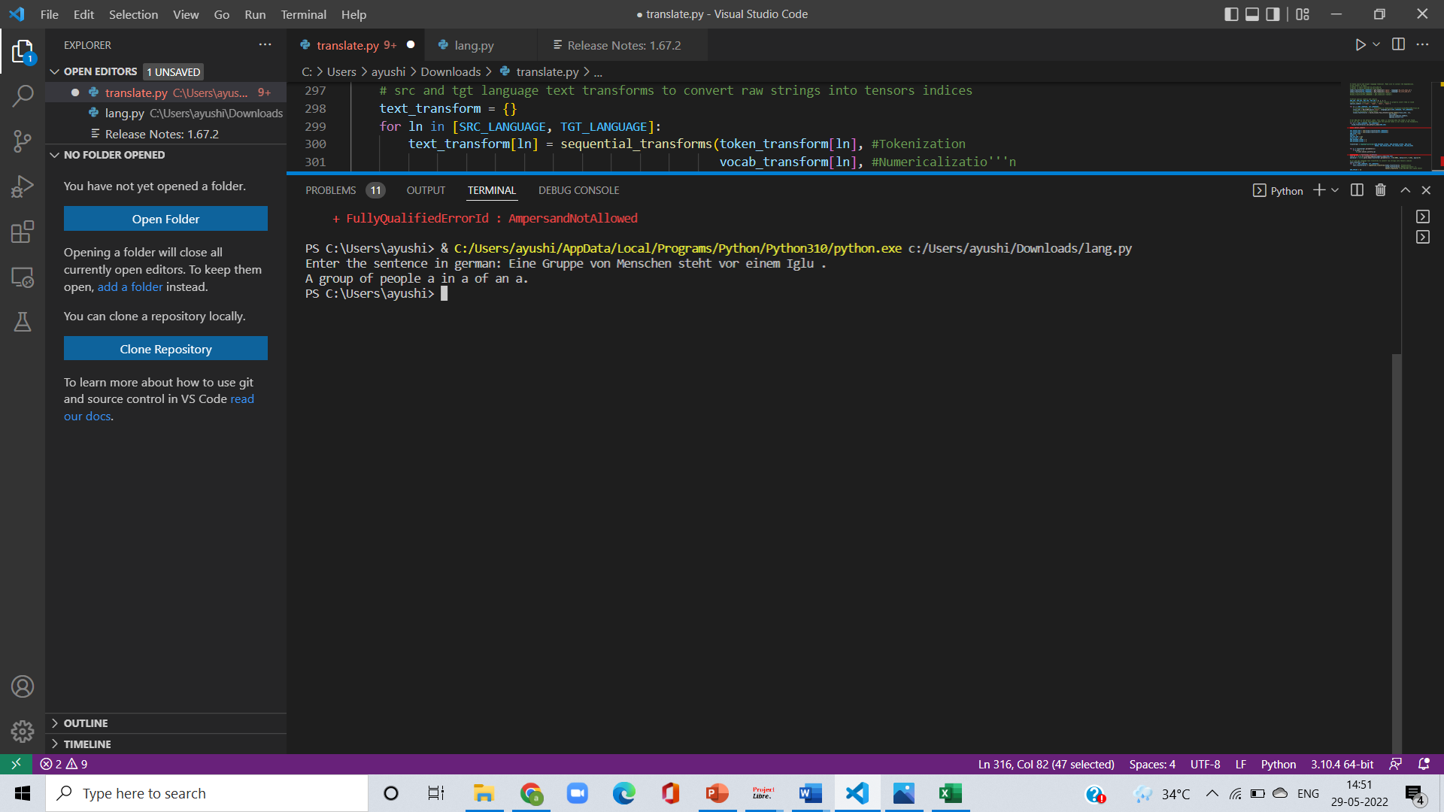
Sample Output

Slide 15
Future Scope of the Project
1
As transformer based model can be used in sequential based data it can be used in protein sequence analysis and in DNA sequence analysis
2
As we are limited to only one language translation in this project ,we can do it for multiple languages
Notes:
This template was inserted from Power-user, the productivity add-in for PowerPoint, Excel and Word.
Get thousands of templates, icons, maps, diagrams and charts with Power-user. Visit www.powerusersoftwares.com!

Slide 16
THANK YOU

